Slide 1

PROJECT: FORECASTING THE FUTURE OF MIAMI Average Weekly Wage
Time Series & Forecasting Analysis for Business
Zheng, Zhi

Slide 2
1. Introduction
My goal is to forecast the possible monthly change in the Average Weekly Earnings of All Employees: Total Private in Miami-Fort Lauderdale-West Palm Beach, FL (MSA).
The data used for this study came from the Federal Reserve Economic Data (Fred), a data source with frequently updated US macro and regional economic time series at annual, quarterly, monthly, weekly, and daily frequencies.

Slide 3
2. Data
Predictor Variables
Average Weekly Wage
Average Hourly Wage
Average Weekly Hours

Slide 4
2. Data Part 2
Autocorrelogram
Partial autocorrelogram

Slide 5
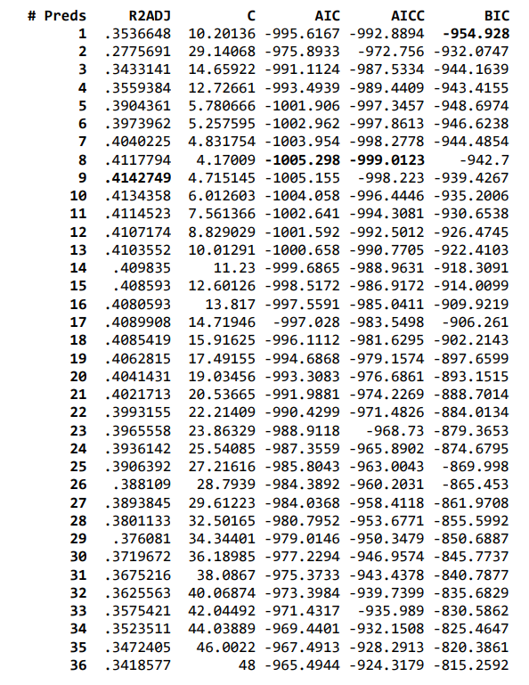
3. Model Selection
12-Lags for WeeklyWage, HourlyWage, and Weeklyhrs
vselect dlnWeeklyWage dlnWeeklyWagel* dlnHourlyWagel* dlnWeeklyHrsl*, best fix( m2 m3 m4 m5 m6 m7 m8 m9 m10 m11 m12)

Slide 6
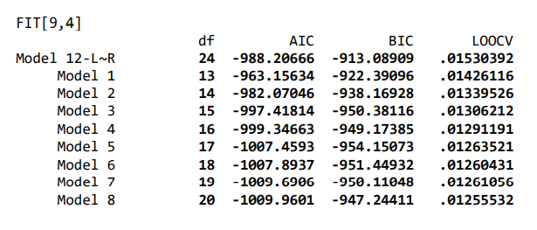
3. Model Selection Part 2
Model 8 has the lowest LOOCV RMSE result and AIC result. Model 5 has the lowest BIC result and predictor amount. In conclusion, Model 5 is the best fit model because it has the best information criterion scores (BIC) and is the simplest model.

Slide 7
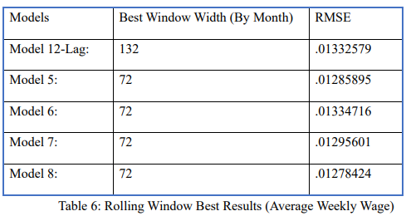
3. Model Selection
After picking the best fit models from the vselect process, then I use the rolling window technique on five different models (Model 12-Lag, and Model 5 to Model 8) based on the best AIC and BIC to make a final model selection for finding the best out of the best fit models with the best prediction window width.

Slide 8
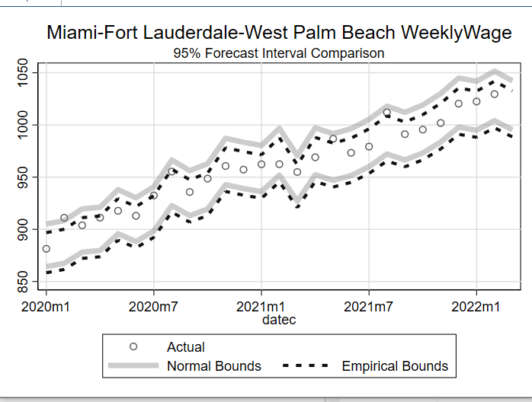
4. Forecast Result
Assumed normal forecast
upper bound: 1042.3,
lower bound of 995.3328,
point forecast: 1018.546.
The empirical forecast
upper bound: 1032.759
lower bound: 988.5123
point forecast: 1032.759.

Slide 9
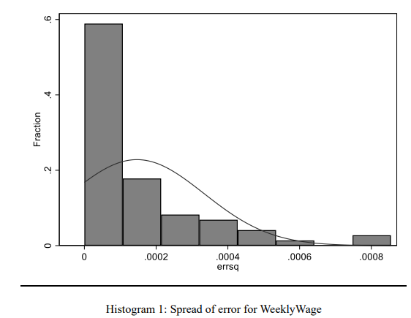
Distribution of Error
Uneven spread/distribution of errors indicating the data is abnormal
The empirical forecast is more accurate

Slide 10
5. Interval Forecast

Slide 11
5. Conclusion
The empirical approaches are more accurate than assumed normal approaches
The one step ahead empirical forecast result for WeeklyWage is 1032.759 for the upper bound, 988.5123 for the lower bound, and 1032.759 for the point forecast.

Slide 12
END
Thank you for listening!

